Slide 1
Korea and Pennsylvania
Old Friends and New Opportunities
Wilfred Muskens
ICAS Summer Symposium
4 August 2012

Slide 2
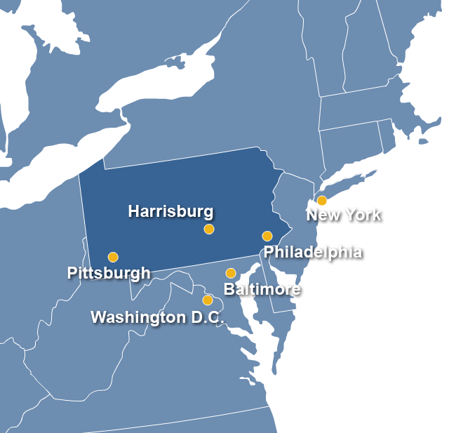
Pennsylvania’s
Profile
Gross State Product:
$569.7 Billion
Population:
12,702,379
Current Employment:
6,469,000
Unemployment Rate (June 2012):
7.5%
Land Area:
119,289 sq km
Notes:
2

Slide 3
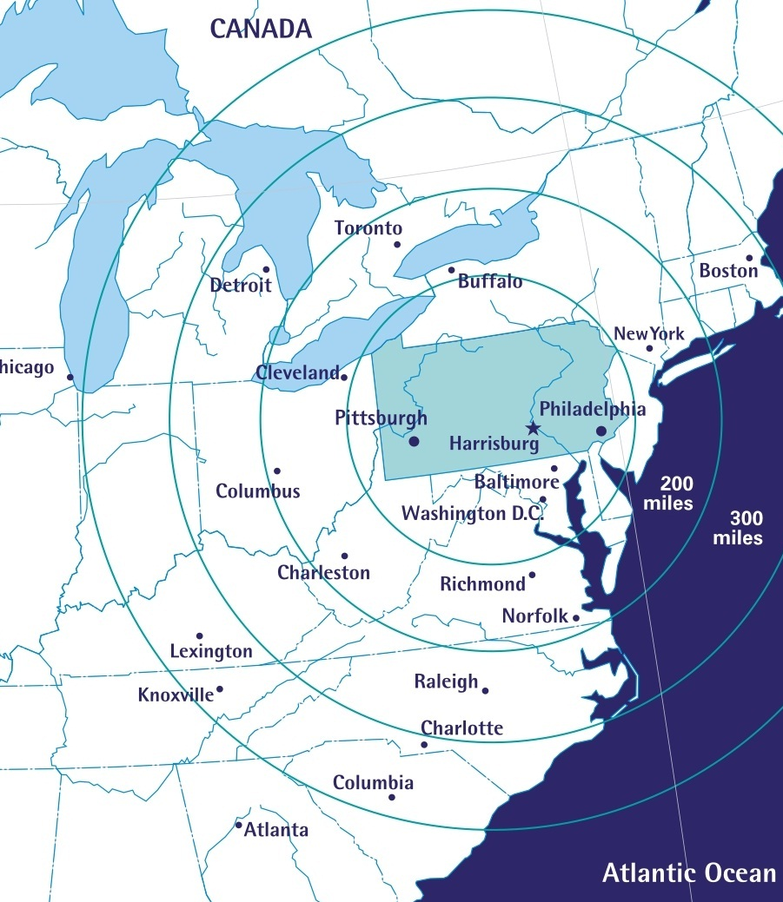
Strategic Location
Six of the ten major US markets are located within 805 km of Harrisburg, Pennsylvania’s capital city, and we are within a day’s drive of:
40% of the US population and purchasing power
More than 60% of Canada’s population
45% of US manufacturers
41% of the nation’s domestic trade and service industries
Reaching those customers and markets is easy and convenient. Pennsylvania’s comprehensive transportation network includes:
An extensive highway system
Modern freight railroad systems
Three major ports providing access to the Atlantic Ocean, Great Lakes, and Gulf of Mexico
Six international airports

Slide 4
The Office of International Business Development (OIBD) develops economic and employment opportunity through its three Centers and…
Center for Direct Investment
Pennsylvania Economic Developers
10 Authorized Investment Representatives
Center for Trade Development
10 Regional Export Network Partners
21 Authorized Trade Representatives
Center for Port Development (PennPORTS)
Port Authorities of Philadelphia, Pittsburgh, and Erie
…innovative initiatives and tools like the…
International Partnerships
OIBD maintains partnership agreements, MOUs, and other relationships with a variety of partners including universities, research institutions, foreign governments, and Pennsylvania alumni
Team Pennsylvania
International Business Advisory Board
International Press Tours
Governor Missions

Slide 5
We are the 19th Largest Economy in the World
Pennsylvania’s Gross State Product - USD $569.8 billion
USD $569.7
billion
USD $318.8
billion
USD $237.8
billion
USD $222.7
billion
USD $103.6
billion
Pennsylvania
Thailand
Malaysia
Singapore
Vietnam
Source: World Development Indicators Database, World Bank, 1 July 2011
South Korea = $1.01trillion
Source: U.S. Bureau of Economic Analysis, 2008 GDP by State, June 2011

Slide 6
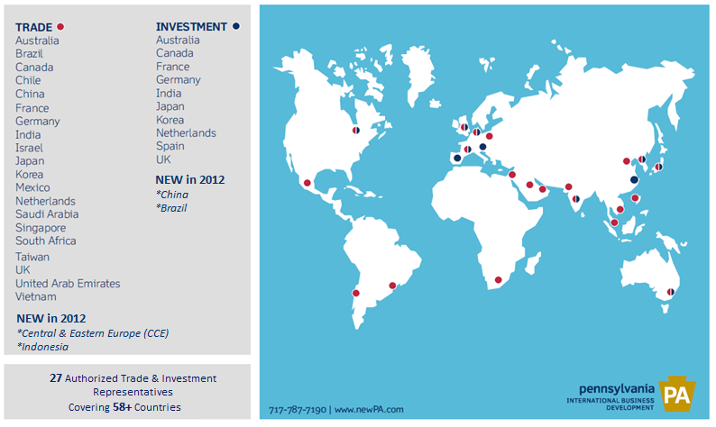
Pennsylvania’s International Representatives

Slide 7
Foreign Direct Investment Impact
5,811 foreign-owned business locations*
- 253,655 jobs supported by foreign firms
1,284 manufacturing companies
- 119,276 manufacturing jobs
4th largest state in the U.S. in number of workers
employed by majority-owned foreign-owned affiliates
Pennsylvania is ranked 5th for insourced manufacturing jobs and 4th for insourced research and design related jobs
“insourced” manufacturing jobs (35%)
other “insourced” jobs
(65%)
Source: D&B, December 2011
Source: U.S. Bureau of Economic Analysis, 2008
*with at least 50% foreign ownership

Slide 8
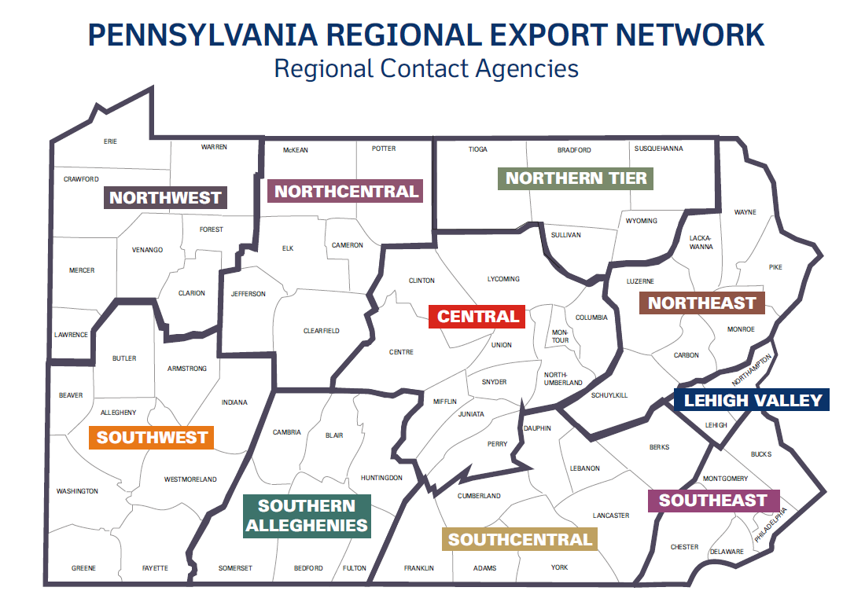
Northwest Pennsylvania Regional Planning & Development Commission
North-Central Pennsylvania Regional Planning & Development Commission
Northern Tier Regional Planning & Development Commission
Northeastern Pennsylvania Alliance
SEDA-Council of Governments
Lehigh University/SBDC Lehigh Export Network
Southwestern Pennsylvania Commission
World Trade Center of Greater Philadelphia
Southern Alleghenies Planning & Development Commission
World Trade Center of Central Pennsylvania

Slide 9
Pennsylvania Exports to Korea
South Korea is Pennsylvania’s 8th largest export destination
Pennsylvania exports in 2011 = $1.07 billion
An increase of 35.9 percent from 2010
Top exports include:
Chemicals
Minerals and Ores
Computer and Electronic Products
Primary Metal Manufacturing
Machinery, Except Electrical
Nonmetallic Mineral Products
Misc. Manufactured Commodities

Slide 10
KORUS FTA
Signed in March 2012, the FTA between the US and Korea is the United States' most commercially significant free trade agreement in nearly 20 years.
The reduction of Korean tariffs and tariff-rate quotas on goods alone is estimated to add $10 to $12 billion to annual U.S. GDP ~$10 billion to annual merchandise exports to Korea.
Under the FTA, almost 80 percent of U.S. exports to Korea of consumer and industrial products will become duty free
Nearly 95 percent of bilateral trade in consumer and industrial products will become duty free within five years March 2012. Most remaining tariffs would be eliminated within 10 years.

Slide 11
Korean Business and Education Connections in Pennsylvania
In 2011 there were 16 companies in Pennsylvania with at least 50 percent Korean-ownership employing 796 individuals.
There are 28,097 international students in the Commonwealth. South Korea is the third largest source (behind India and China) with 11.3% of the total. Estimated foreign student expenditures in the state are $887.9 million. Pennsylvania has the seventh largest number of the fifty states.
Pennsylvania is home to over 40,000 individuals of Korean descent and has a wide range of Korean cultural and business organizations throughout the commonwealth. As a result, there are many connections between Korea and Pennsylvania, including sister-city agreements between Philadelphia and Incheon and Montgomery County and Gwanak-gu. Additionally, Philadelphia has the fifth largest Korean population in the United States.

Slide 12
Life Sciences
Pennsylvania is the leading state in biotechnology* and is the
center of life science innovation in the US thanks to our:
world-class research institutions
emerging and mature companies
global pharmaceuticals
support organizations
Pennsylvania is also the leader in Private-Sector Life Sciences Facility Development**
Success Stories
Atrium Innovations
PDMS Almac
MAPI Group
Osstem Co., Ltd.
*Source: Business Facilities Rankings Report, July 2008
**Source: Site Selection Magazine, May 2009 (by tally of qualifying projects)
Notes:
Atrium Innovations Canada
PDMS Almac Ireland
B. Braun Medical Inc. Germany
MAPI Group France
Osstem Co., Ltd South Korea
Unilife Australia

Slide 13
Food Processing
The food processing industry in Pennsylvania accounts for over
$22 billion in sales annually.
Pennsylvania is known as the “Snack Foods Capital of the World”
PA ranks 2nd nationally in the sale of potato chips and similar snacks and 3rd in
milk production and bread and bakery products
There are over 2,300 food-processing companies in the commonwealth, ranking PA as number one among the 50 states in the value of shipments of canned fruits and vegetable specialty products, chocolate and cocoa products, potato chips and pretzels.
Success Stories
The Hershey Company
Campbell’s Soup
H.J. Heinz
Kellogg’s
Kraft
Godiva Chocolates
M&M Mars
Stroehmann Bakeries
Tyson Foods

Slide 14
Medical Devices
The combination of advanced manufacturing capabilities coupled with Pennsylvania’s life sciences industry make it an ideal location for medical device manufacturers.
Pennsylvania ranks:
1st in the U.S. for biotechnology strength
3rd in medical equipment and supplies manufacturing
In top 5 nationally for the number of life sciences and medical device firms
4th in academic R&D
5th in number of doctoral scientists
8th in number doctoral engineers
General business environment; flexibility of labor and regulations
Success Stories
Meta BioMed
B. Braun Medical Inc.
Unilife
Notes:
Atrium Innovations Canada
PDMS Almac Ireland
B. Braun Medical Inc. Germany
MAPI Group France
Osstem Co., Ltd South Korea
Unilife Australia

Slide 15
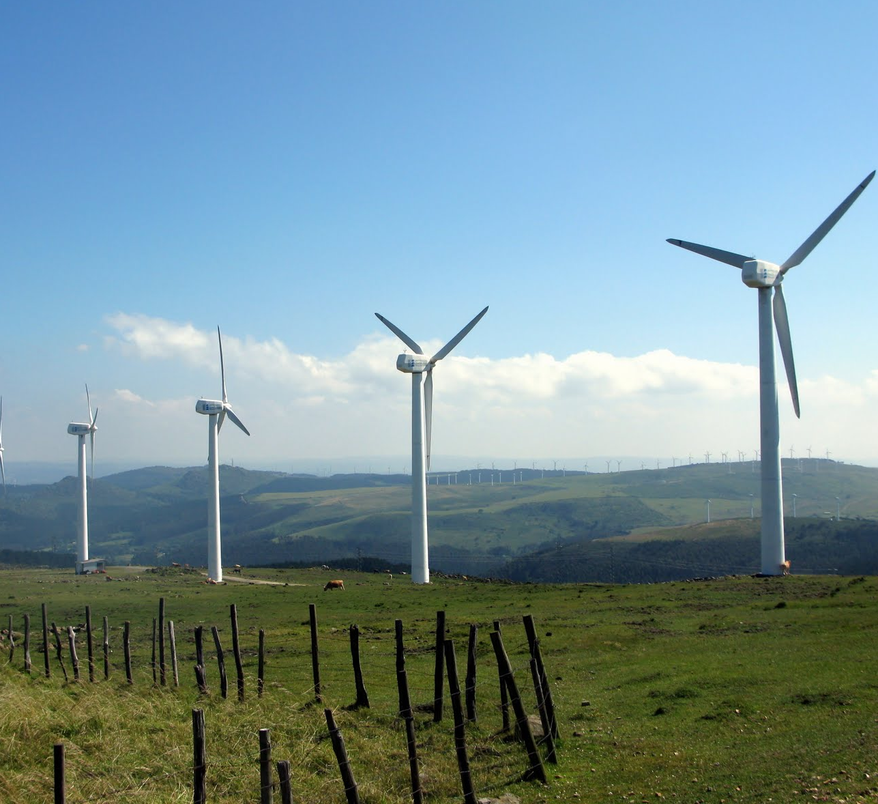
Energy
Energy leaders, including a wide range of suppliers and manufacturers call Pennsylvania home. A few key factors that attract companies involved in energy industries include:
Strong supply chain, deep manufacturing capabilities, a central location and vast transportation network.
Wind
PA is expected to have between 3,000 - 4,000 megawatts of wind energy installed by 2021, enough to power 850,000 homes.
Solar
Under existing legislation, Pennsylvania must install at least 1 million MWHs of solar energy capacity by 2021. PA is expected to add 850 MWHs of clean solar energy by this time, enough to power about 80,000 homes.
State attraction efforts include grant programs offered by PEDA and Energy Harvest, which collectively have awarded over $4 million in funding assistance to companies involved in solar energy. PA also received $200 million in additional funding.
PA’s Alternative Fuel and Biomass Resources include:
Bio-based/wood waste feedstock, methane gas produced by biodigesters, coal reserves for coal-to-liquid facilities and land for raising cellulosic crops for ethanol development.
Pennsylvania has the manufacturing capacity to provide at least 85 million gallons per year of biomass-based fuel

Slide 16
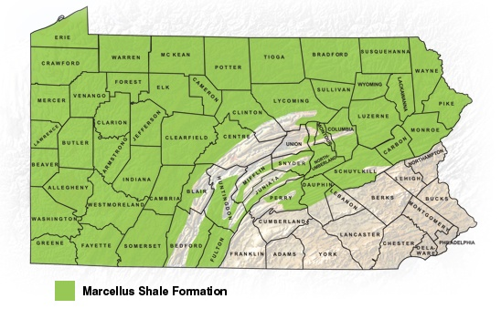
Natural Gas
Under two-thirds of Pennsylvania lies the Marcellus Shale, the largest
known shale deposit in the world. With advances in drilling technology, natural gas extraction has become a major opportunity for the Commonwealth.
In addition to the potential for drilling and recovery companies, there are many
opportunities for the following:
Drilling rigs
Tubular goods
Slurry blender
Fracturing pumps and tanks
High pressure treating iron
Low pressure pipes and gauges
Metering equipment and gas-processing systems
Directional drilling and water treatment equipment
Success Stories
Talisman Energy
TRICAN Well Service
BOS Solutions
FracServe

Slide 17
News and Updates – Social Media
Follow us on Twitter
@tradePA
@investPA
Center for Trade Development (CTD) account
Tweeting news about export assistance and promotion activities
Target audience are local Pennsylvania companies and economic development partners
Center for Direct Investment (CDI) account
Tweeting about Pennsylvania industries and investment opportunities
Target audience are international companies and local economic development partners

Slide 18
Office of International Business Development Department of Community & Economic Development
감사합니다!
Commonwealth Keystone Building
400 North Street, 4th Floor
Harrisburg, PA 17120 USA
Phone: 717-787-7190
Fax: 717-772-5106
Wilfred Muskens
Deputy Secretary
Office of International Business Development
717-720-7354 | wmuskens@pa.gov
www.newPA.com/international

