Slide 1
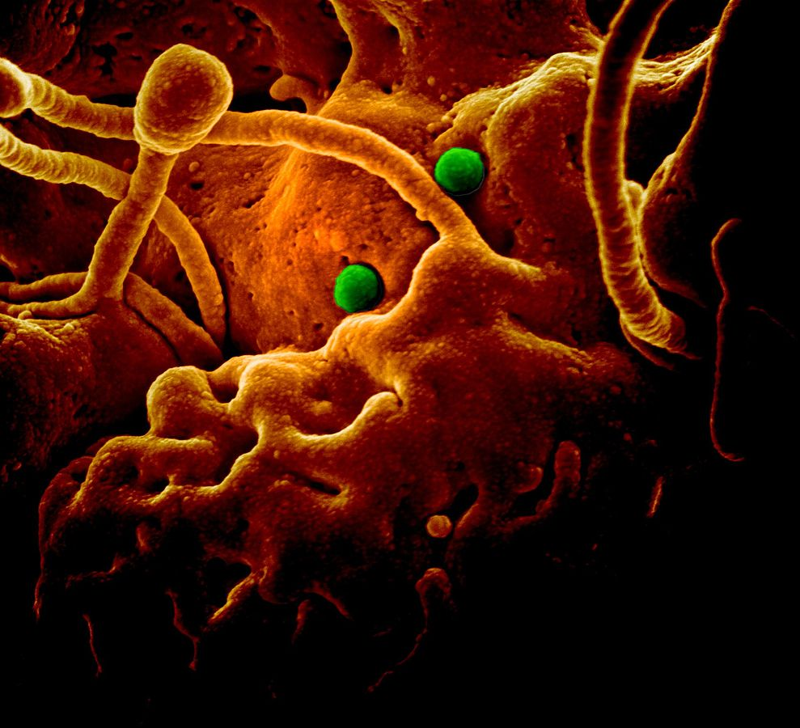
South Korea’s Moon Administration, Its “Chinese Dream” and the Wuhan Virus
ICAS Winter Symposium
February 13, 2020
Tara O
NIAID [CC BY (https://creativecommons.org/licenses/by/2.0)]
Notes:
2 years ago at the ICAS Winter Symposium, I talked about the Moon Jae-in administration and its pro-North Korea stance—its desire to form a “low level federation” with North Korea, which is exactly the Kim Family Regime’s long-stated goal of Goryeo Federation. It forms a supra-entity over both South Korea and North Korea, and that becomes the new central government, and it is really designed to be dominated by North Korea, which is why NK has long sought it.
Today, I’m going to talk about the Moon administration’s pro-China stance. There has been many instances, but the way it has been handling the Wuhan Virus outbreak is telling of just how much it submits itself to China. I want to emphasize that the Moon administrations’ submissiveness to China is not supported by most South Koreans, so we need to separate the people from the Moon govt.

Slide 2
Wuhan Virus, Coronavirus, China Pneumonia, 2019-nCov, etc.
Epicenter: Wuhan, Hubei Province, People’s Republic of China
2019/12: 41 people developed pneumonia of unknown causes in Wuhan
2020/1/23: China quarantines Wuhan
by 2020/2/11, CCP Official count: 43,101 infected; 1,017 deaths
China’s govt criticized–slow to respond, under report
World Health Organization (WHO)—also slow to respond
Other countries: ban travelers from China, evacuations, quarantine
Spreading fast

Slide 3
Moon admin’s responses to the Wuhan Virus
Moon on a 4-day vacation
Headlines around the world: Wuhan Virus, Wuhan Coronavirus, China Pnuemonia, etc.
2020/1/27: Blue House tells reporters to use “New-type of Coronavirus” (delete “China”)
Told journalist to use “Chairman” Kim Jong-un and “Yeosa” for Li Seol-ju
Korea Communications Commission (KCC) threat if not complied
1/28: Visits the National Medical Center
Tells people to not worry if follow procedures are followed
Threatens the medical community: If they don’t’ follow his guidelines, then “there are a number of administrative censures.”
1/30: Moon--“Fake News” about Wuhan Virus is a “serious crime,” will be “strictly dealt with.”

Slide 4
Rapid Support to China
2020/1/30: SK gave 3 Million masks, 10,000 protective suits, 10,000 protective gloves, etc. to China
Extra $5 million paid to China just before evacuation flights of Koreans from Wuhan
Approval from China took time, with cancellations
Was 1/30, but delayed to 1/31 (US, Japan evac’d on 1/29)
2 flights (rather than 4 flights) approved eventually
SK Jaebols donated to China
1/31, Samsung: 1 million masks, 10,000 protective suits, ~$4.5 million
1/28, Hyundai: Masks, goggles, etc. ($700,000+), ~$1.5 million
CJ, LG, SK, POSCO, Asiana Airlines, Amore Pacific, etc.
South Korea faces mask shortages, high prices

Slide 5
1/28: South Korean Military Evacuation from China
124 ROK military quarantined after returning (due to the Wuhan virus) from a “field exercise(s)” in China, says news report:
Army: 41
Navy: 22
Air Force: 27
MND: 34
What were these “exercises?”
Consult with ROK ally, the U.S?
MND has not made an official statement

Slide 6
Moon government’s Responses
1/28: Lee In-Young, the Floor Leader of Deobureo Minjoo Party (Democratic Party of Korea, DPK), said China is a "precious friend" that South Korea must live with and help, going forward
Made no comments when Hong Kongers asked for support
Does not prevent entry of Chinese to SK, despite:
Citizen’s Petition to ban entry (698K+ signed as of 2/12)
Korean Medical Association (KMA) strongly recommended ban
North Korea closed borders almost immediately, later Russia, Mongolia, etc.
Blocked Chinese visitor entry by late Jan: US, Italy, Philippines, etc.
62 countries took measures
2/2: Finally blocks those from Wuhan/creates a separate entry area
But China already quarantined the city (1/23)
100s of tourists from Wuhan already in Korea, many unable to be reached
KMA says bit too late, KMA/citizens still call for full ban
Notes:
1/30: WHO declared “global emergency” over the epidemic
1/30: US raised travel alert to level 4; “Do Not Travel” to China
1/30: Israel, Italy blocks flights to/from China

Slide 7
South Korean Concerns
Colleges/Universities: 70,000 Chinese students
Up to 50,000 are/will be CCP/Youth League members (estimated)
Many receive scholarships from SK govt, priority in dorms
SK students worried (semester starts in March)
2020/2/6, Poll: 77% want complete restriction of entry of Chinese
As of 2/12, BH Petition to block entry of Chinese: 698,034
10,000-30,000 Chinese enter South Korea daily
100s of flights
Linked to 40 Chinese cities
KMA: Some doctors can’t get masks (shortage)

Slide 8
“Submissive Diplomacy” to China?
Moon, 2020/2/3:
“China’s difficulties are linked to our difficulties.”
“South Korea should suffer together with China and be in solidarity with China, and only then would SK be a true neighbor and can face the future together.”
“As a neighbor, we shouldn’t skimp on support and cooperation.”
Moon, 2/10: The Wuhan Virus is “not a serious illness in South Korea yet & the death rate is not that high”
Moon Criticized for “submissive diplomacy”
Notes:
Very different than they way it treats its other neighbor, Japan.

Slide 9
China’s New Ambassador to South Korea--Xing Haiming
Arrived in Seoul 2020-1-30; Gave a press conference 4 Feb (before SK gives him credential)
“Chinese government is transparently cooperating internationally.”
Urged following the WHO guideline and not restrict entry of Chinese
WHO: slow to respond.
Stated “moderate” risk, when it was “high”--admitted on 2020-1-28
Declared “global health emergency” on 2020-1-30
Notes:
Xing arrived in SK 2020-1-30; not yet credentialed, but held a press conference.
Very different response than the one for the US Ambassador to SK, Amb Harris

Slide 10
China’s Former Ambassador to Seoul 9/2019
China’s former Amb to South Korea Cho Guohong (started 2014-2)
“South Korea & China are a community/collective with shared destiny (운명공동체)”
Criticized Japan: “There’s already economic cooperation with Japan underway, but Japan is always guarded toward China, so the quality of cooperation is low.” “South Korea-China relations will be different than (the relations with Japan) and stable.”
China “will play an active/aggressive role on the Korean Peninsula.”
He‘ll work hard for Xi Jinping to visit South Korea (Mar, now June)
“Currently, the relations at the ministerial level are completely the best.”

Slide 11
China Eastern Airline assigned South Korean flight attendants on domestic routes in China to dangerous cities
SK attendants usually on flights between South Korea and China
Starting 2019/12, SK flight attendants put on flights to dangerous cities in China, including Wuhan
Replaced Chinese, French & Japanese flight attendants on domestic routes
Forbade its employees from talking to the media after a frightened South Korean flight attendant told Newsis
Flight Attendants hope the South Korean government will help
Notes:
How China views South Korea

Slide 12
2 SK Journalists Beaten by Chinese Security Guards during Moon Jae-in’s Visit to China 14 Dec 2017
Notes:
Moon attended ROK-PRC Economic Partnership convention sponsored by KOTRA at the National Convention Center in Beijing. The SK journalists had formal pass to cover the event. They followed Moon and his entourage, and the Chinese security guards blocked them and beat up the journalists from the Korea Times and Economy Daily. The security guards grabbed them by the neck and threw them on the floor. One was taken out to the hallway and was beaten up by 10 security guards. One BH official tries to stop them from beating up the reporter, and the security guards knocked him down as well. Journalist Lee had an orbital fracture.
China never apologized.

Slide 13
China’s Mistreatment of SK President Dec 2017 3 nights/4 days
Moon arrived in Beijing on 13 Dec 2017
Xi Jin Ping went to Nanjing; Changed dinner to the next day
PM Li Keqiang: cancelled lunch, delayed the meeting to afternoon
China cancelled joint declaration, joint press conference
Had only 2 official meals with Chinese officials
1 in Chongqing with local party secretary
China disallowed meetings with Standing Committee members

Slide 14
Moon’s visit to China, Dec 2017
Notes:
Eating “alone” without counter parts
-former ROK ambassador to China, now Moon’s Chief of Staff Noh Young-min on left, Moon’s wife on right

Slide 15
Moon’s Visit to China Dec 13-16, 2017
Had KBS Orchestra play “Military Anthem of the PLA”
=March of the 8th Route Army (under Mao Zedong)
Ethnic Koreans in the 8RA fought ag/ S Korea & UN forces (Korean War)
Moon Jae-in said:
“China is not just China, but its existence shines when it socializes with surrounding countries.”
“As the highest mountain peak socializes with the surrounding lower peaks, it is elevated even higher.”
China is a “great power.”
South Korea is a “small country.”
“I hope the Chinese dream is not just for China, but for all of Asia, and all of humanity.”
“South Korea will join the Chinese dream and go together”
Notes:
ilitary Anthem of the People’s Liberation Army was March of the Eight Route Army.

Slide 16
Links to China & CCP
THAAD
3 No’s
Selection of LG U+ 5G Network by the SK Central Election Committee for early voting
LG U+ uses Huawei equipment
Huawei: backdoor, beaconing
Cho Kuk: Co-Link Private Equity Fund
Huakun Science & Technology Development (public) Corp: $525M
2019/7: Democratic Party of Korea (DPK) signs agreement with CCP
Choo Mi-ae (DPK), 2017/10/9: “If Henry George were alive, he could have supported the Chinese method of giving the land use right to inmin and the land ownership to the government” (Inmin is proletariat)
Lee In-young (DPK), 2020/2/5: Wants to add “Collectivization of Land” in the Constitution after the April 15 election

Slide 17
Choo Mi-ae, Democratic Party of Korea at CCP Hosted High-Level Dialogue, Beijing, 2017
Notes:
CCP invited political parties from around the world for Chinese Communist Party and World Political Party High-Level Dialogue 30 Nov – 3 Dec 2017.
NK did not attend.
SK’s Choo Mi-ae attended. She was the National Assmblywoman, Deobureo Minjoo Party (Democratic Party of Korea) then. Moon appointed her as the Justice Minister after his prior appointment Cho Kuk, was mired in a scandal. The prosecutor is still investigating Cho Kuk.

Slide 18
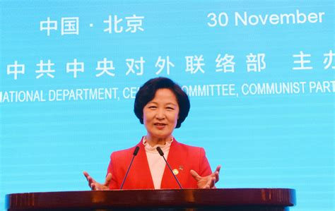
Notes:
Choo Mie-ae speaking at the CCP event in 2017.

Slide 19
Is the Moon Administration Aligning South Korea with the Chinese Communist Party?
Using “official” figure from China, as of 2020-2-12
Notes:
https://gisanddata.maps.arcgis.com/apps/opsdashboard/index.html#/bda7594740fd40299423467b48e9ecf6

