Slide 1
ICAS Polling I - 2019
The Korean Peninsula Issues
and
US National Security
www.icasinc.org
Copyright 1999 © - 2019 © ICAS All Rights Reserved. Unless Otherwise Noted All Contents Copyrighted.

Slide 2
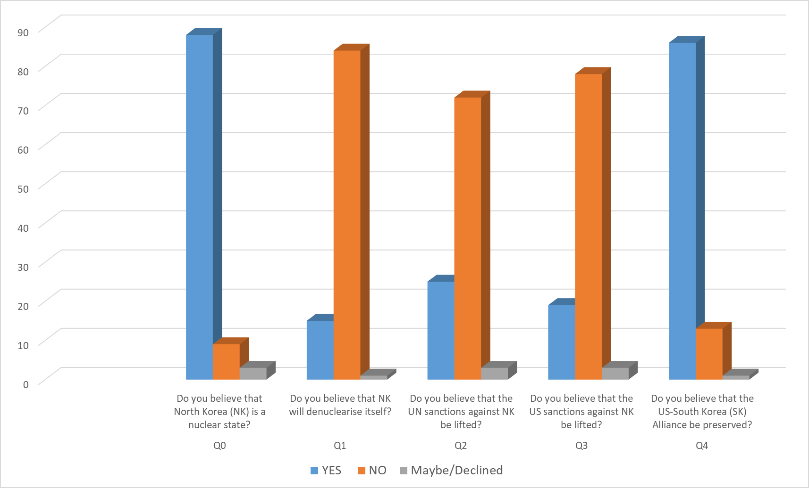

Slide 3
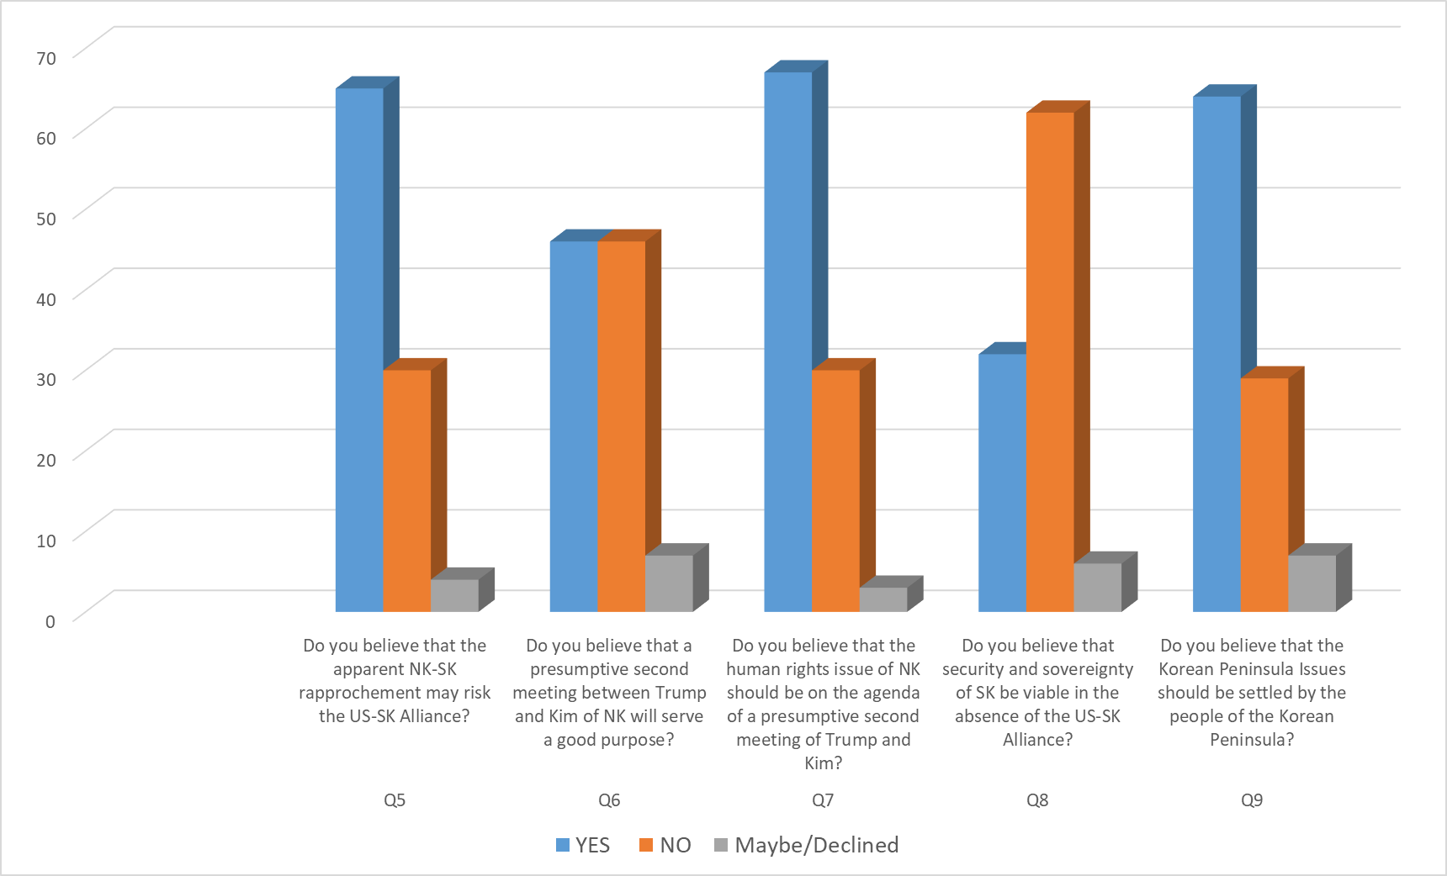

Slide 4
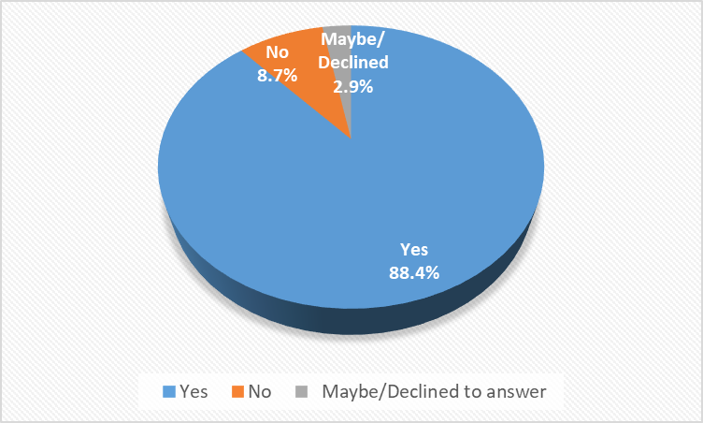
Q0. Do you believe that North Korea (NK) is a nuclear state?

Slide 5
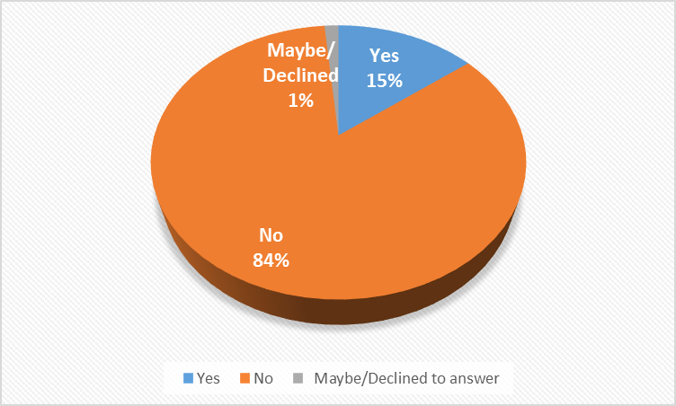
Q1. Do you believe that NK will denuclearise itself?

Slide 6
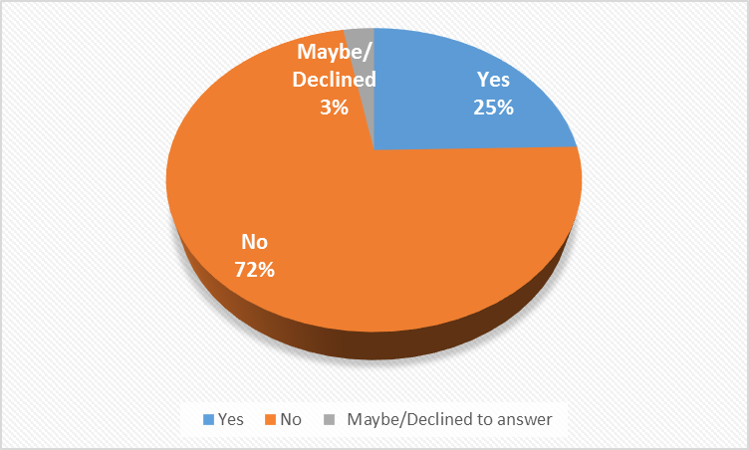
Q2. Do you believe that the UN sanctions against NK be lifted?

Slide 7
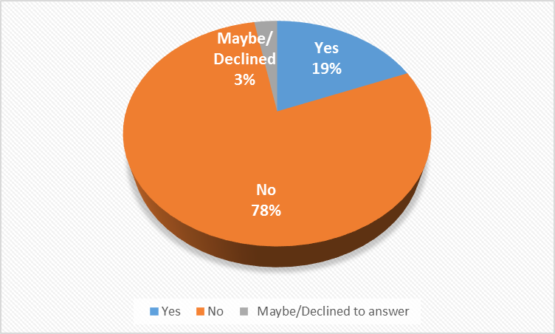
Q3. Do you believe that the US sanctions against NK be lifted?

Slide 8
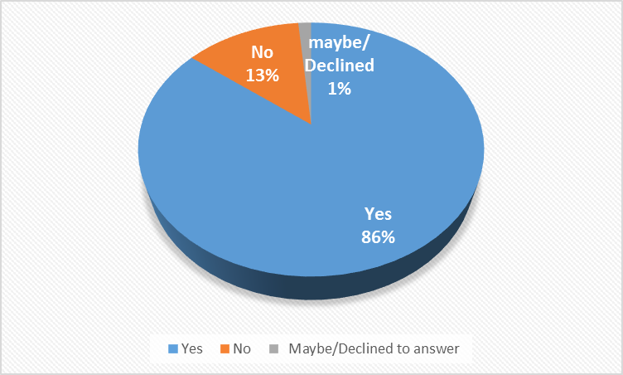
Q4. Do you believe that the US-South Korea (SK) Alliance be preserved?

Slide 9
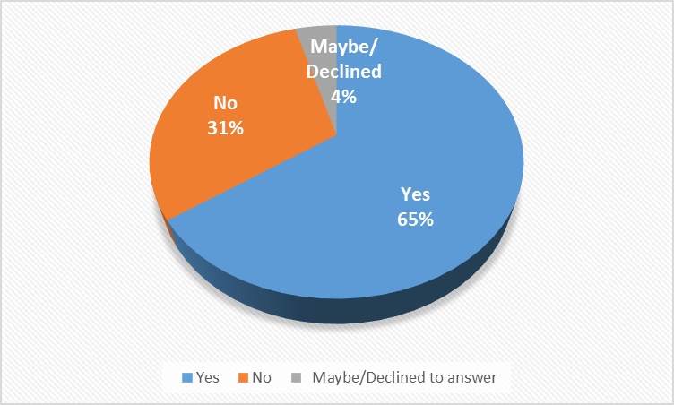
Q5. Do you believe that the apparent NK-SK rapprochement may risk the US-SK Alliance?

Slide 10
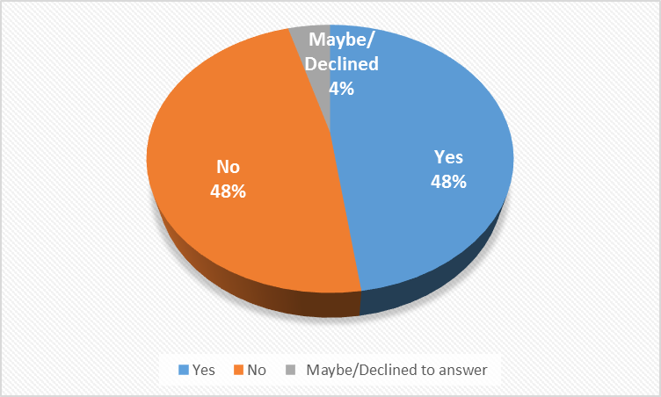
Q6. Do you believe that a presumptive second meeting between Trump and Kim of NK will serve a good purpose?

Slide 11
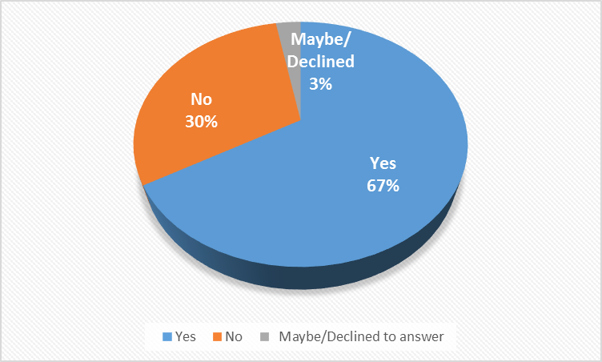
Q7. Do you believe that the human rights issue of NK should be on the agenda of a presumptive second meeting of Trump and Kim?

Slide 12
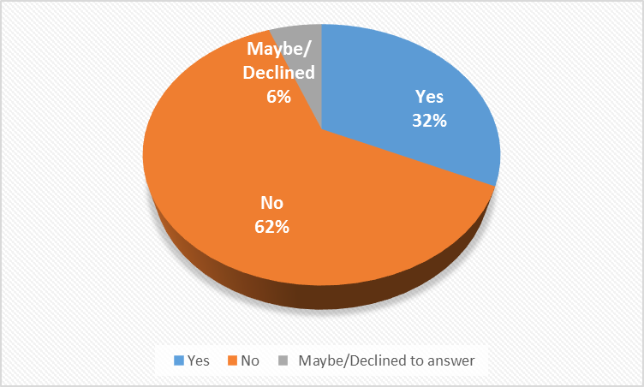
Q8. Do you believe that security and sovereignty of SK be viable in the absence of the US-SK Alliance?

Slide 13
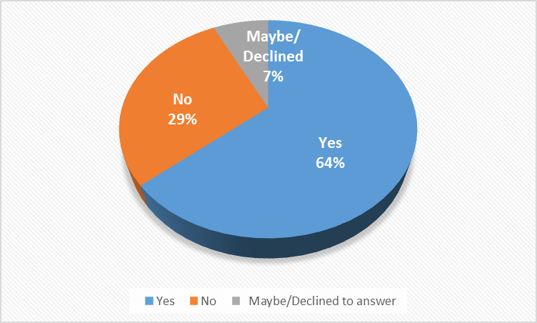
Q9. Do you believe that the Korean Peninsula Issues should be settled by the people of the Korean Peninsula?

Slide 14
N.B.
0. January 3, 2019 - January 11, 2019 1. Email 2. Assumption 3. ICAS Audience on the Hill 4. Credibility Interval
Confidence Interval
5. Not Agent of Foreign Government/Power/Principal
(18 USC §951; 22 USC §611) 앞잡이
6. No Foreign Funds
X

Slide 15
This work is dedicated to late Lawrence R Klein.
friend
colleague
mentor
teacher

Slide 16
The ICAS Polling I Data
ICAS Strategy
ICAS Winter Symposium Prologue

Slide 17
Il Hwan Kim
Sang Joo Kim
David Lee

